Slide 1





Slide 2
Roadmap
Code available at https://github.com/cybertraining-dsc/su21-reu-361
Thought process
Implementation
Results and Conclusion

Slide 3


Motivation
Cryptocurrency is confusing
What is a blockchain???
Not to mention Artificial Intelligence (AI)
Endeavor to learn these concepts
Huge profitability

Slide 4

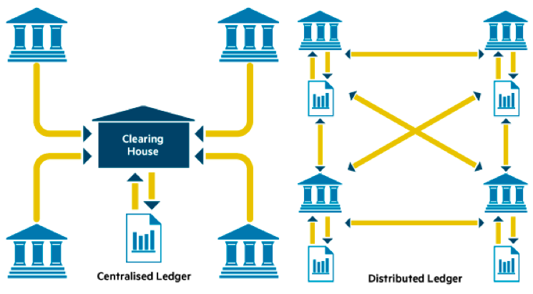


Blockchain
Bitcoin
United States
Dollar
EOS

Slide 5
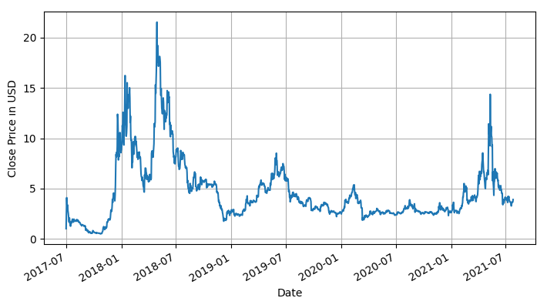
Time Series
EOS-USD
Look at that volatility!

Slide 6
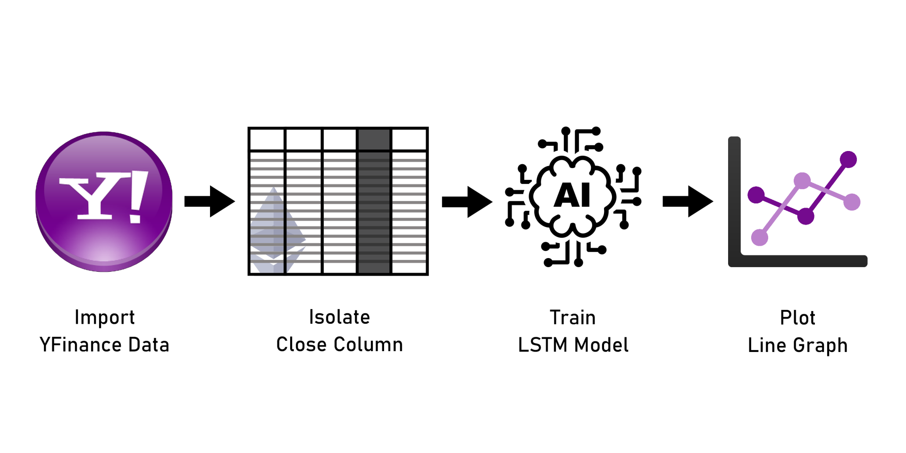
Architecture

Slide 7
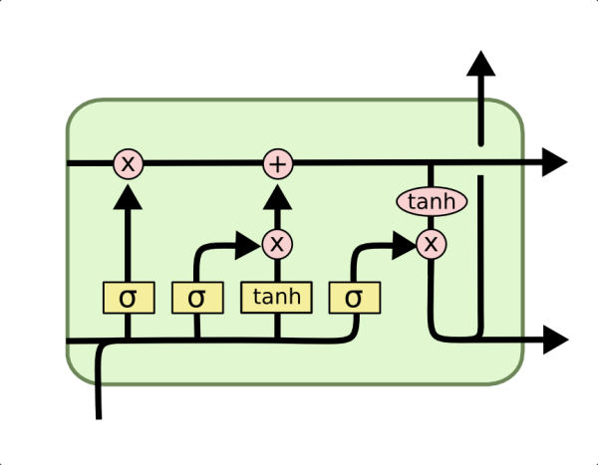
Long Short-Term Memory (LSTM)
Neural network
RNN
Has a memory capacity
Model goes through a predefined number of epochs

Slide 8
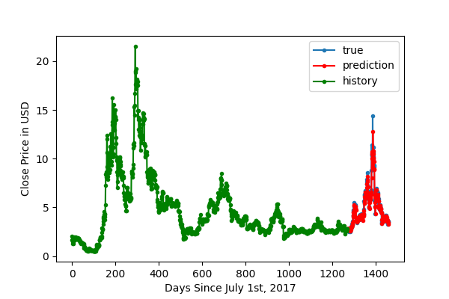
Results
EOS-USD

Slide 9
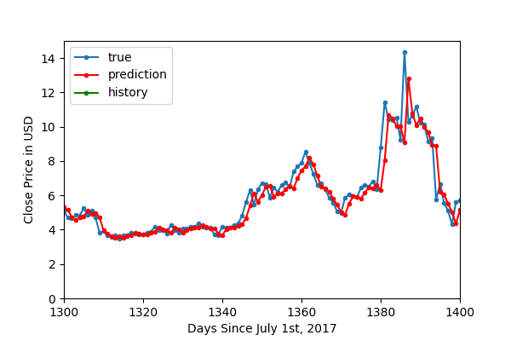
Results
Figure: a zoomed-in graph of EOS prediction model
overlayed on the actual EOS price
EOS-USD
Mean Squared Error: 0.485 USD

Slide 10
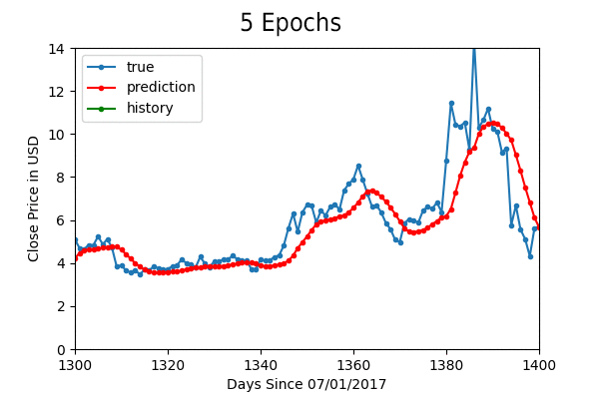
Results
An animated graphic of number of epochs’ effect on prediction

Slide 11
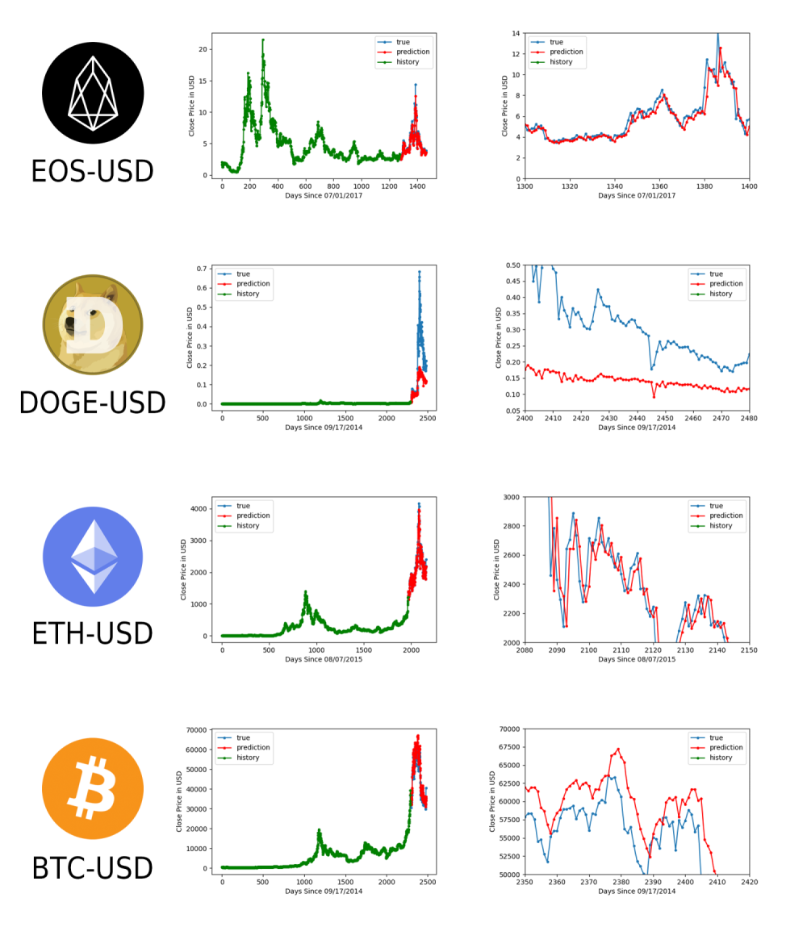
Various cryptocurrency predictions

Slide 12

A SMASHING SUCCESS!!
...right?

Slide 13

Conclusion
No way to predict the future
Random walk theory
Randomness contradicts memory capacity of LSTM
Future research: analyze Twitter feeds from influencers

Slide 14

Takeaways from REU
Experience
There are so many ways to implement AI
Convolutional neural network, recursive neural network, artificial neural network
How to use GitHub, Visual Studio Code, PyCharm
Thanks to instructors!

Slide 15
Acknowledgments
Dr. Yohn Jairo Parra Bautista of FAMU
Dr. Carlos Theran of FAMU
Dr. Gregor von Laszewski of Indiana University
Florida A&M University
Miami Dade College School of Science

